Slide 1
Esperanto

Slide 2
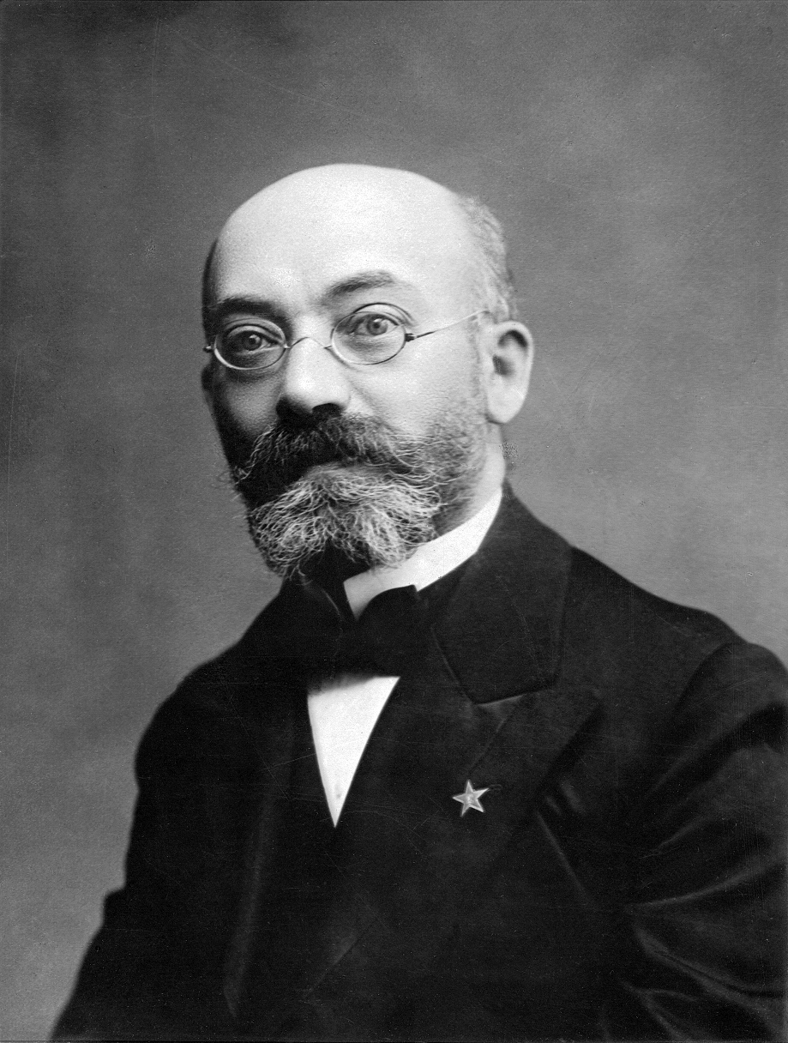
When and by whom did he create Esperanto?
Esperanto was created in the late 1870s and
early 1880s by L. L. Zamenhof, a
Polish-Jewish ophthalmologist from
Białystok, then part of the Russian Empire
but now part of Poland.
źródło:Wikipedia

Slide 3
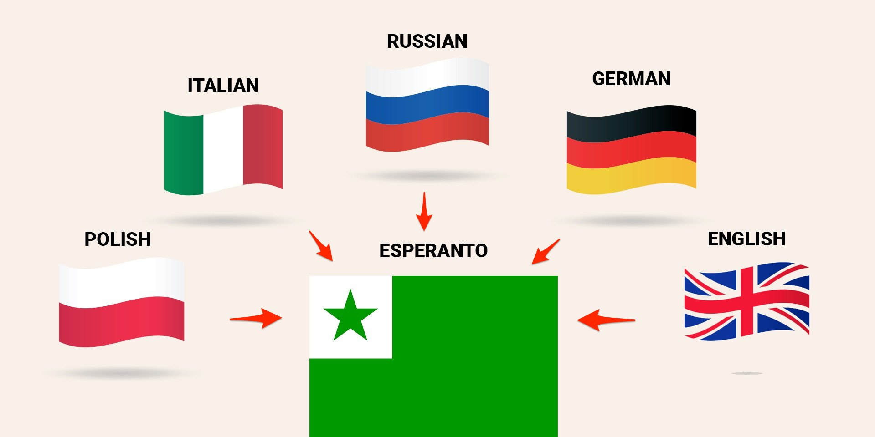
Esperanto was created by combining
Language:
-Polish
-Germany
-English
-Italian
-Russian

Slide 4
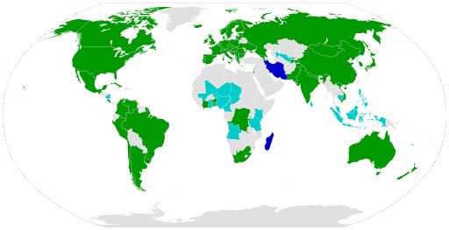
How many people speak Esperanto?
Esperanto is spoken in the world by several hundred thousand to even two million people.

Slide 5

Flag Esperanto
The flag of Esperanto
is all green with a star
in a white square

Slide 6
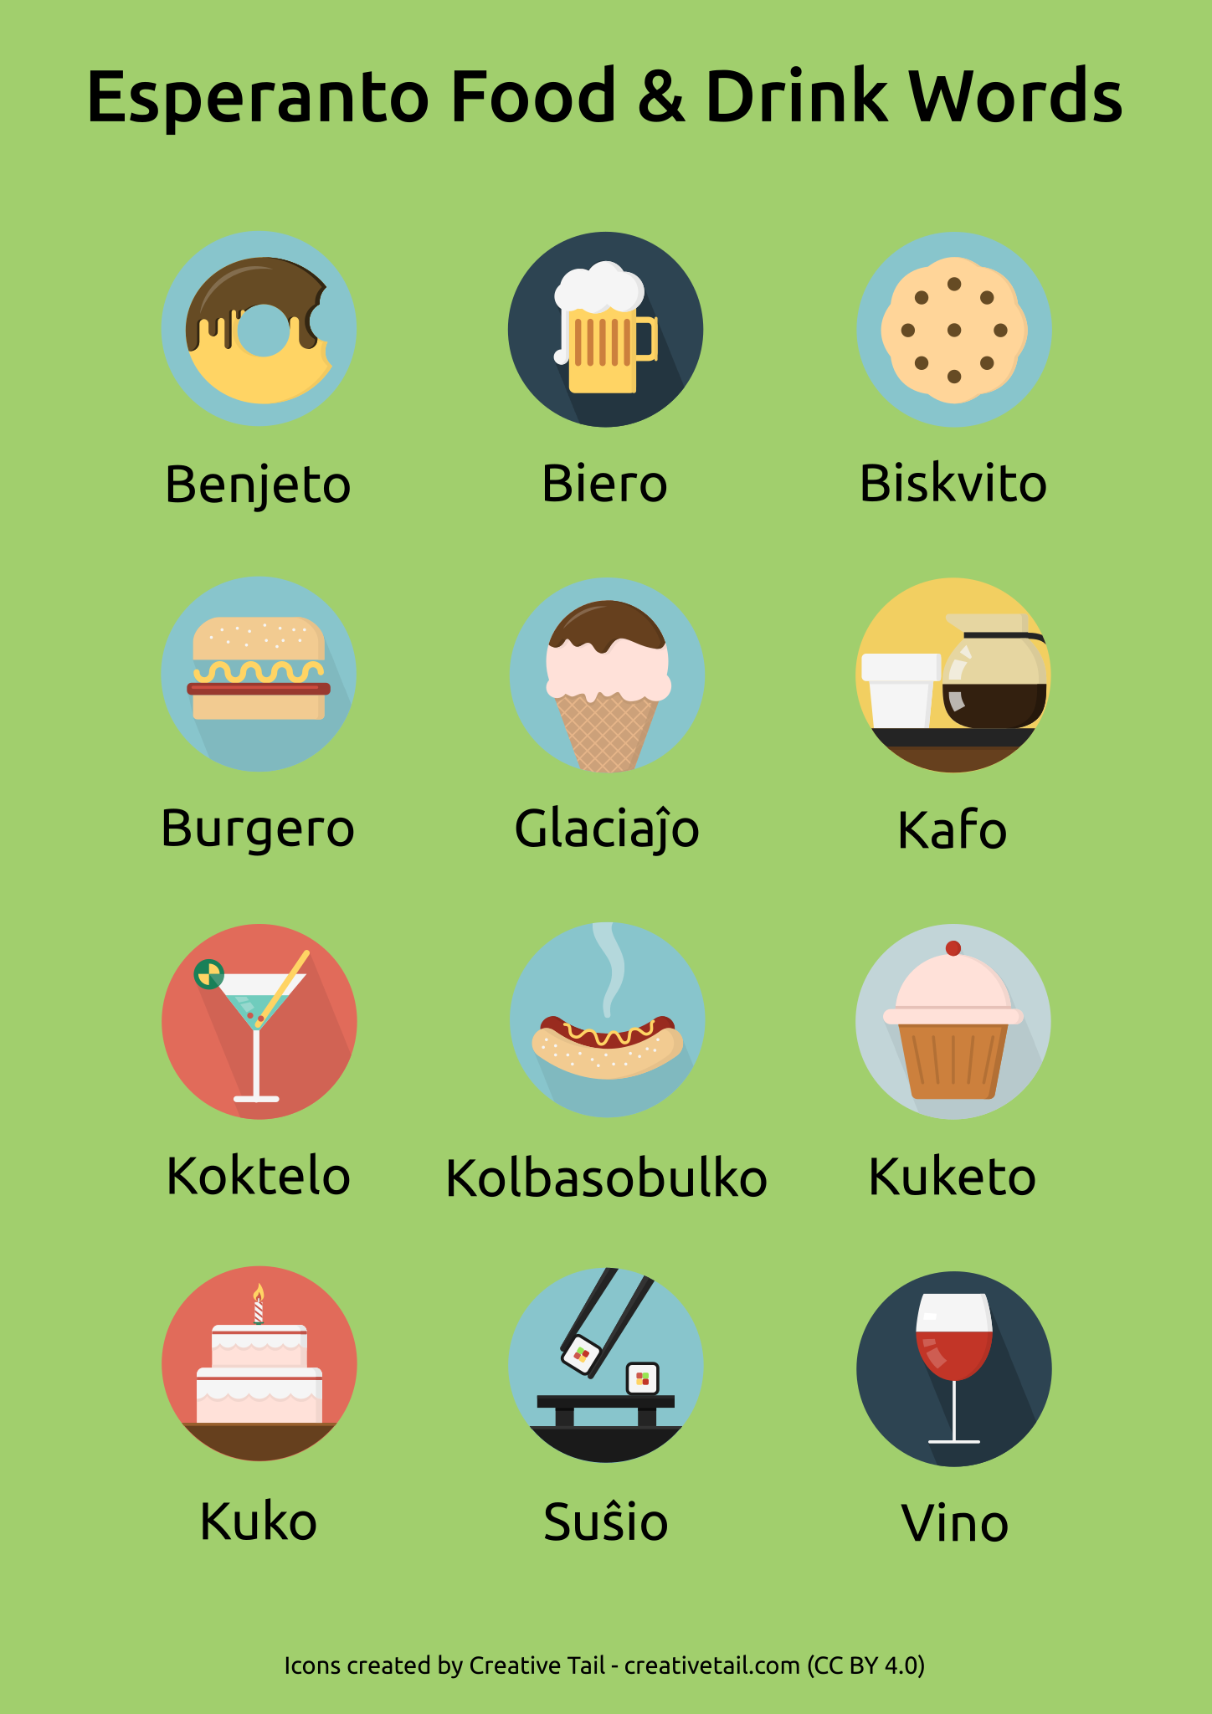
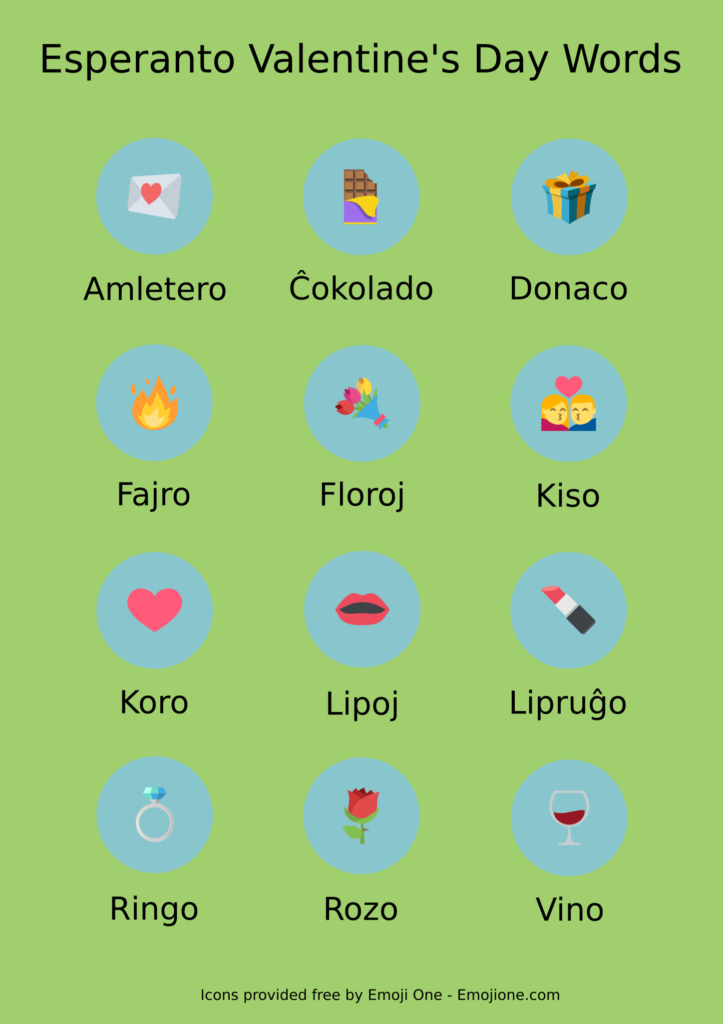
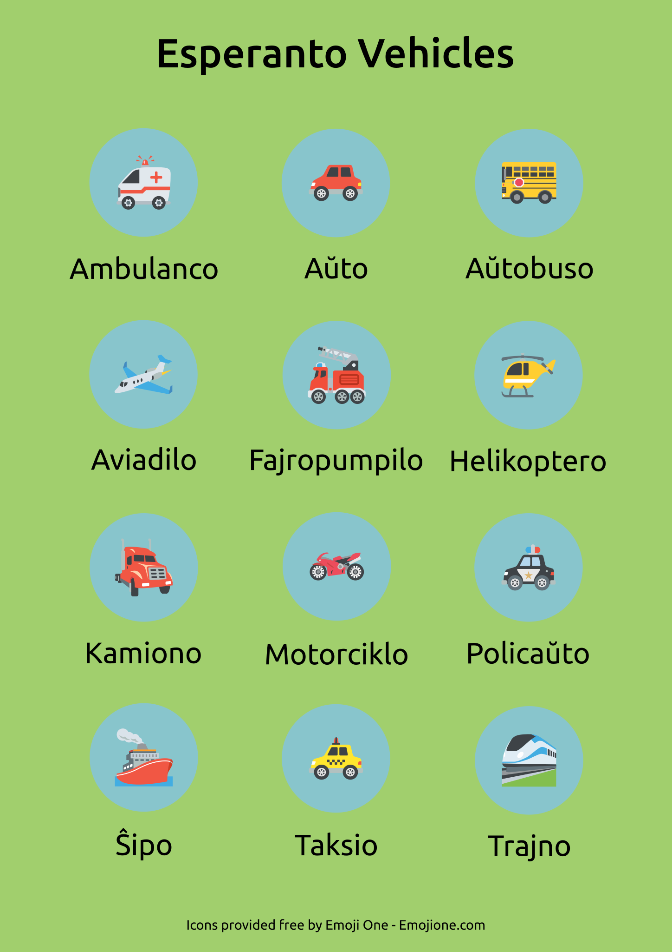
Sample words in Esperanto

