Slide 1
What is Esperanto?
Michał Łuszczewski 1 TFP

Slide 2
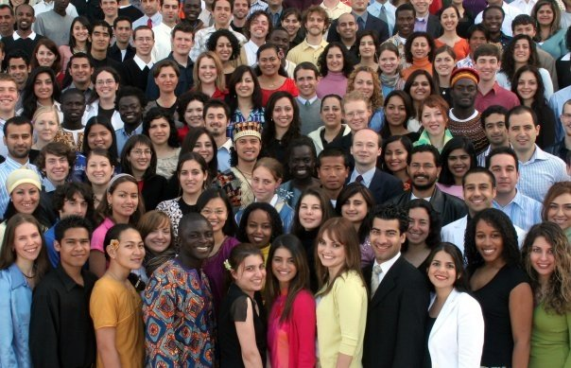
It’s a language that is particularly useful for international communication.

Slide 3
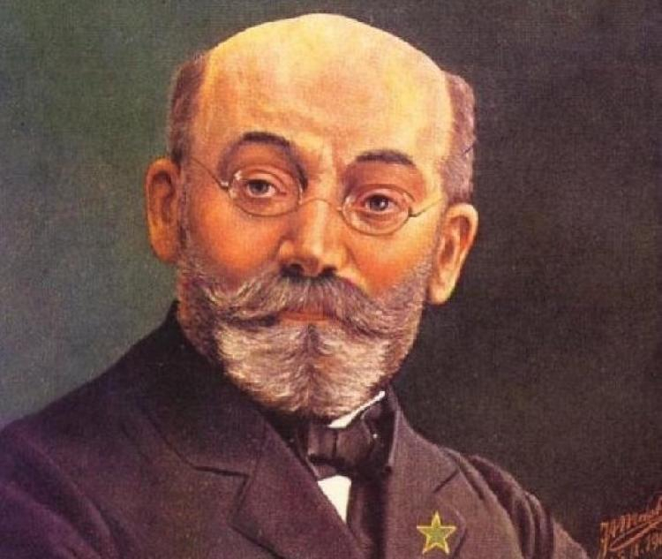
The language was initiated by Ludwig Lazar Zamenhof. He created the grammar on the basis of European languages. The vocabulary is mostly based on Romance languages, although there are also worlds germanic and other languages.

Slide 4
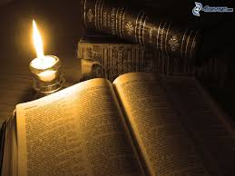
1878
The first primitive version of Esperanto, whitch Zamenhof named Lingwe Uniwersala, is completed. However, it differents considerably from mordern Esperanto.

Slide 5
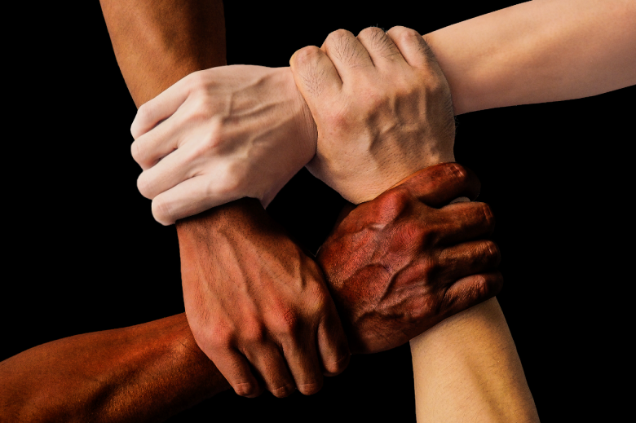
“The internal idea of esperanto is the foundation of a neutral language will help break down barriers between peoples andn help peoples get used to the idea that each one of them should see their neighbors only as a human being and a brother.”
L.L. Zamenhof, 1912

Slide 6
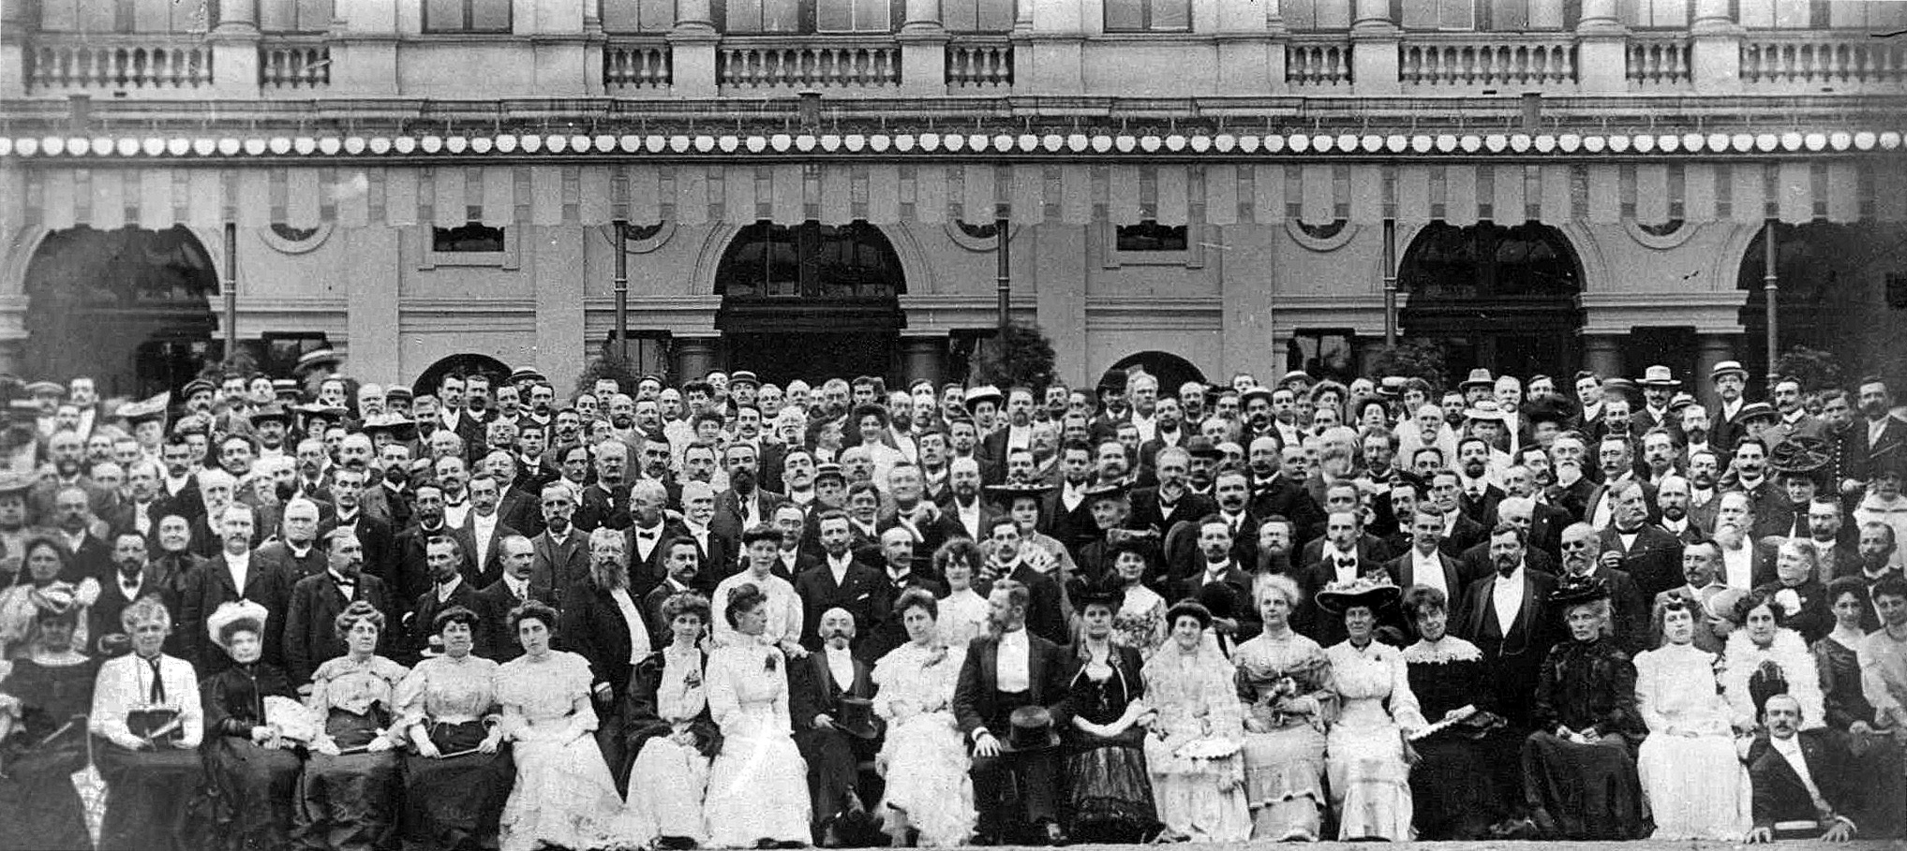
1905
The first Universala Kongreso (World Congress) is held in Boulogne-sur-Mer, with 688 participants.

Slide 7
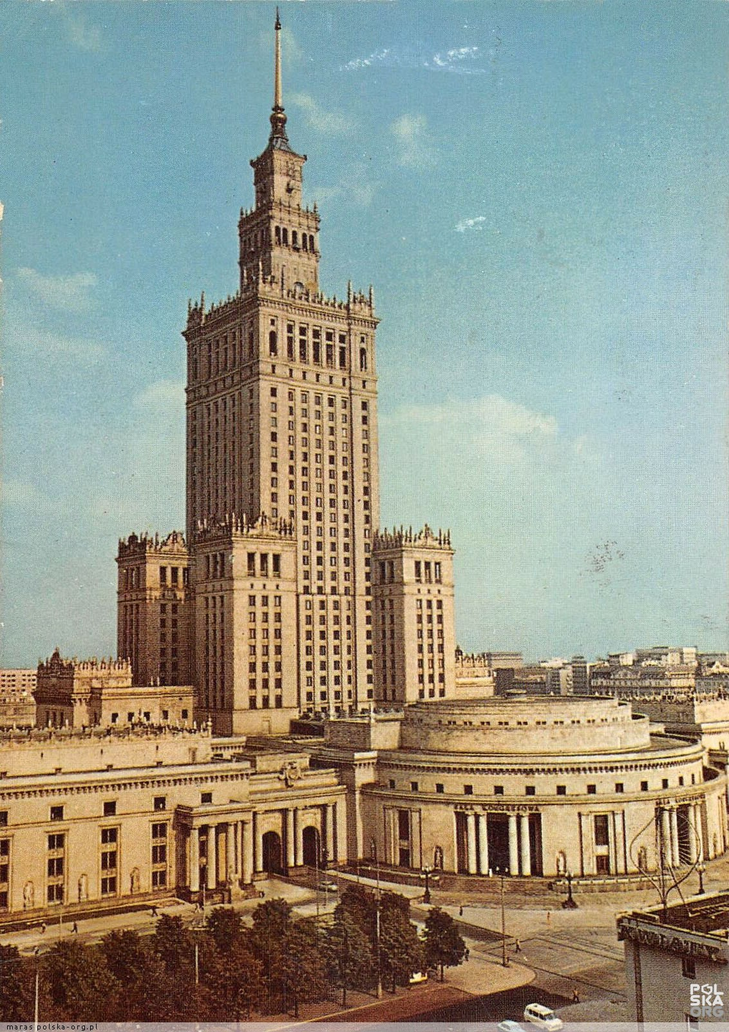
1987
6000 Esperantists attend the 72nd Universala
Kongreso in Warsaw to mark Esperanto's centennial.

Slide 8
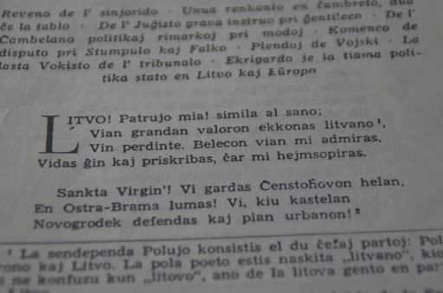
Esperanto is a language that is learnable and worth learning.

Slide 9
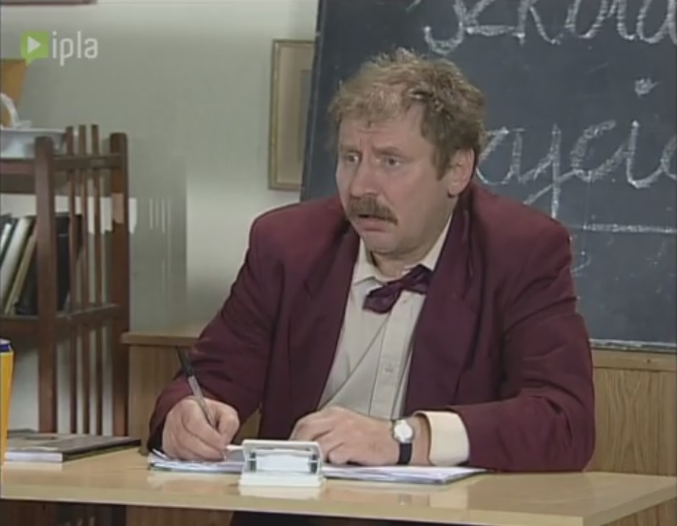
Esperanto is a language of the future.

