Slide 1
ESPERANTO
~~~hopeful person
Aleksandra Sobiech

Slide 2
Table of Contents
Introduction (what is this?)
Creator / Circumstances of the uprising
Usage
Language basics / symbols
Interesting facts

Slide 3
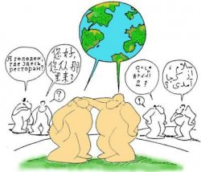
The creator dreamed of making such situations widely known.
Esperanto is artificial language .
I
V
It’s means that he became invite by someone. Idea to make new international language was born from observations his invitor. He made this language ap help people.
______________________________________________

Slide 4
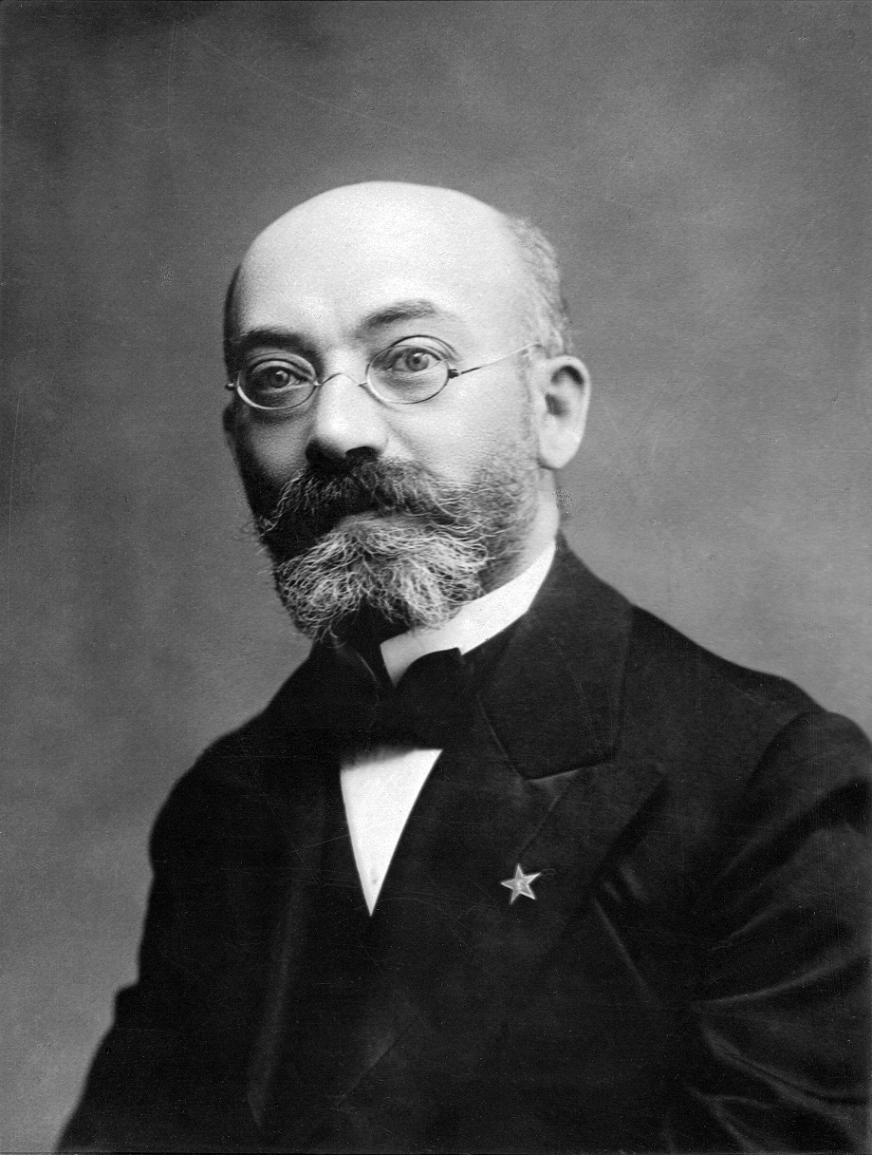
Ludwik Zamenhof
Our compatriot, an ophthalmologist living in Russian-occupied Polish lands, Białystok (where he was born) is the author of "Esperanto"
Its name comes from the nickname "Dr. Esperanto ”under which Ludwik Zamenhof published in 1887 the basics of the language in a book
International language. Foreword and a complete manual. (by clicking you can read more)
already as a student he started working on a project of a new language common to all people.
______________________________________________
Miejmy świadomość całej wagi dzisiejszego dnia, bo dzisiaj w gościnnych murach Bulonii nad Morzem spotkali się nie Francuzi z Anglikami, nie Rosjanie z Polakami, lecz ludzie z ludźmi (...)

Slide 5
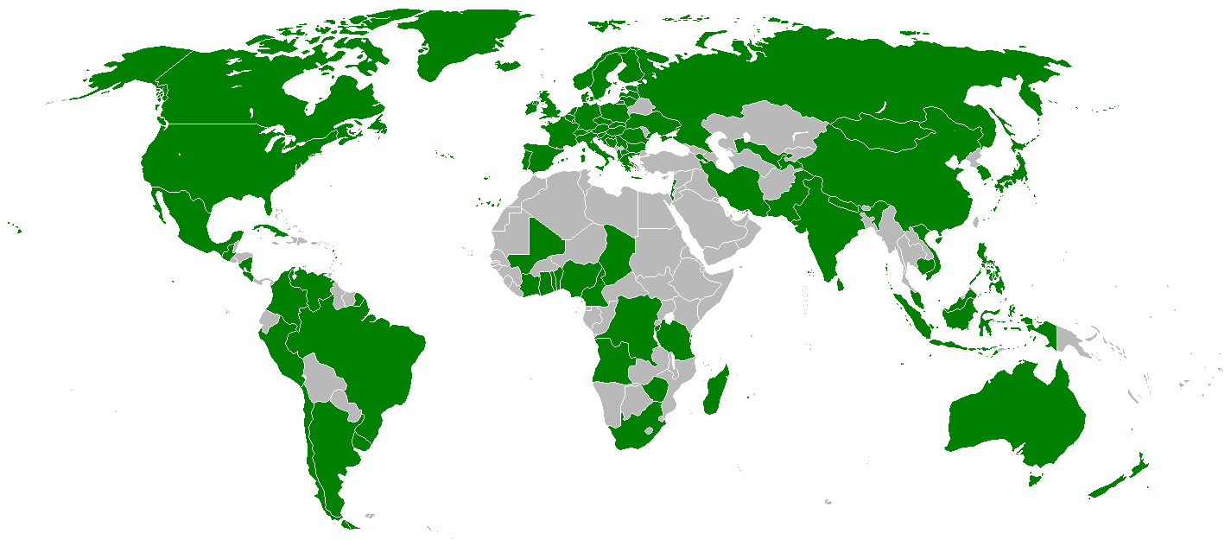
Use of language
Esperanto is spoken in the world by several hundred thousand to even two million people.
Esperanto is by definition a universal language that is easy to learn, regardless of cultural differences.
Esperanto is the language used primarily by Esperanto lovers who associate all over the world in Esperanto clubs.
In any country in the world of Esperanto
has not been recognized as an official language.
______________________________________________
Aby język stał się powszechnym, nie wystarcza nazwać go takim (...) Język międzynarodowy, jak każdy narodowy, jest własnością ogółu; autor zrzeka się na zawsze wszelkich praw osobistych do niego.

Slide 6
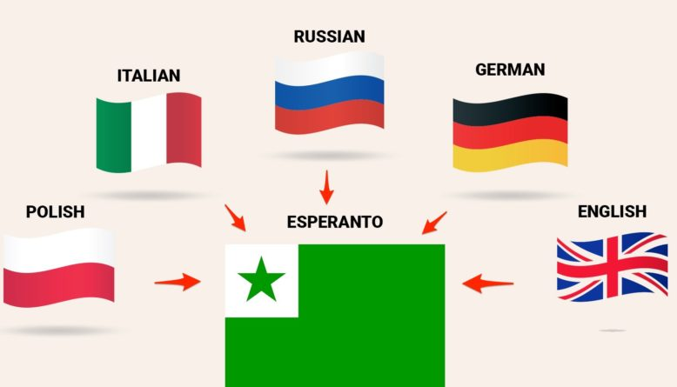
______________________________________________
Some say that English is the easiest foreign language.
Ludwik Zamenhof's work was thought out with great precision. The grammar here is made to be simple and quick for anyone to learn
We need less time to learn it

Slide 7
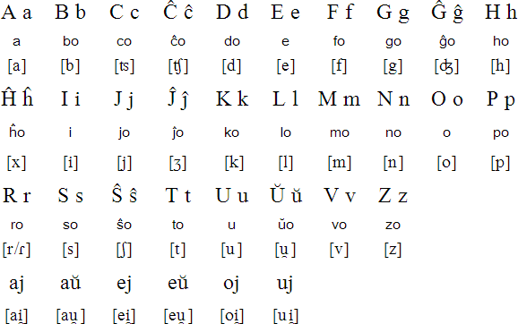
Alphabet Esperanto
______________________________________________

Slide 8
Letters and pronunciation
Esperanto uses 28 letters, 5 of which are vowels:
a b c ĉ d e f g ĝ h ĥ i j ĵ k l m n o p r s ŝ t u ŭ v z
The word roots in Esperanto come from different languages, about 75% from Romance languages, about 20% from Germanic, and about 5% from other languages
Here are some examples:
from Latin sed (ale), tamen (jednak), okulo (oko), akvo (woda) from French: dimanĉo (niedziela), fermi (zamknąć), ĉevalo (koń), butiko (sklepik) :from Italian ĉielo (niebo), fari (robić), voĉo (głos) from English: birdo (ptak), suno (słońce), ŝarko (rekin), teamo (zespół) from Poland: celo (cel), ĉu (czy), krado (krata), luti (lutować)
______________________________________________

Slide 9
Basic words and phrases in Esperanto:
Sinjorino! - Mrs
Bonan tagon! - Good morning
Ĝis revido! - goodbye
Kiel vi statas? - how do you do?
Mi estas Jan Kowalski - My name is Jan Kowalski
Jes - yes
Ne - No
Basic numerals:
1 - unu 2 - du
3 - tri 4 - kvar
5 - kvin 6 - ses
7 - sep 8 - ok
9 - naŭ 10 - dek
100 - cent 1000 -mil
______________________________________________

Slide 10
Symbole
Green means hope
The star is a symbol of Esperanto, it symbolizes the five inhabited continents.

Slide 11
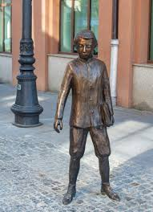
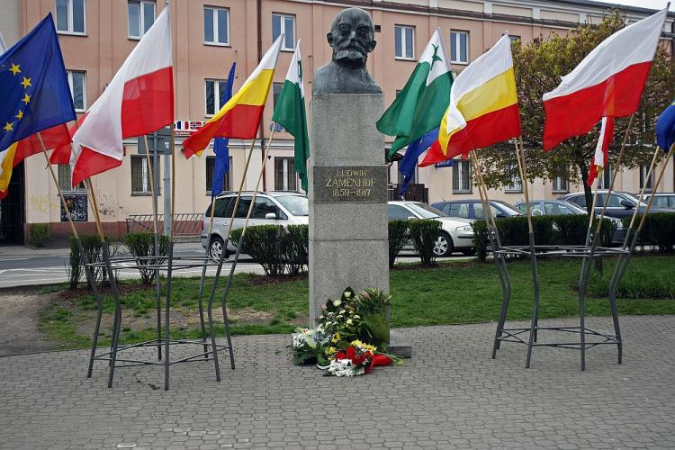
______________________________________________
Interesting facts
There are several statues of Ludwik Zamenhof in Białystok

Slide 12
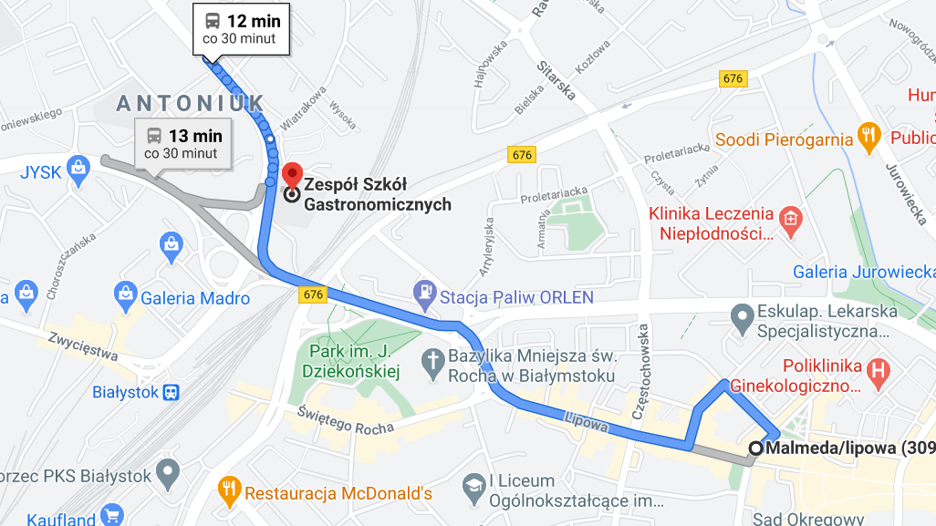
______________________________________________
His name has been given, for example, to names of streets or stops
By driving through one of them (in Białystok) number 308 you can get to the building Zespołu Szkół Gastronomicznych :)

